Slide 1
TEXAS DUO – FREEZE DAMAGE DROUGHT DAMAGE
POMONA HOA
September 15, 2022
PRESENTED BY DR. ROBERT E. MOON, HORTICULTURAL CONSULTANT

Slide 2
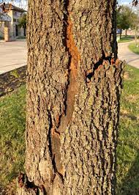
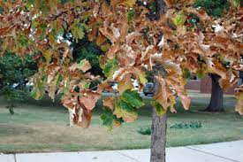
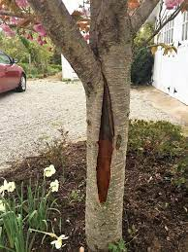
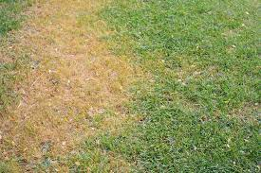
PLANT RECOVERY Winter Storm Uri – February, 2021 Drought Damage – Summer, 2022
FREEZE DAMAGE
DROUGHT DAMAGE

Slide 3
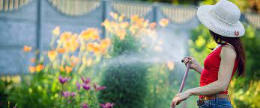
PLANT RECOVERY WATERING
FOLLOW WATER RESTRICTIONS FOR YOUR CITY
DRIP IRRIGATION AND BUBBLERS ON TREES ARE OFTEN NOT RESTRICTED
NEWLY PLANTED LANDSCAPE – WATER FOR SURVIVAL AS PER CITY GUIDELINES
IF RESTRICTIONS WORSEN, WATER FOUNDATION, TREES AND SHRUBS BEFORE TURF
HAND WATERING IS EFFECTIVE WAY TO AID IN PLANT SURVIVAL
DO NOT FERTILIZE PLANTS UNTIL TEMPERATURES MODERATE AND/OR RAINS RETURN

Slide 4
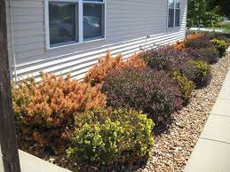
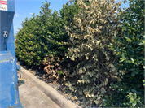
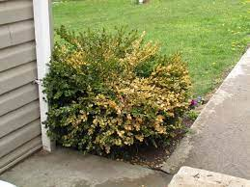
Dead wood can be trimmed out of trees and shrubs at any time!
PLANT RECOVERY
REMOVING DEAD WOOD

Slide 5
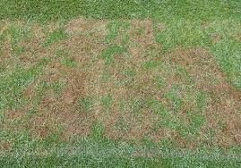
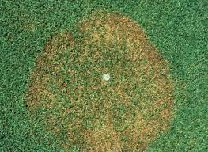
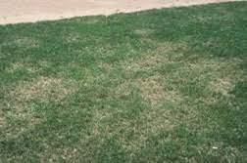
PLANT RECOVERY CONTROLLING INSECTS AND DISEASES ON TURF
INSECTS:
Grubworms
DISEASES:
Pythium
DISEASES:
Rhizoctonia
DISEASES:
Grey Leaf Spot

Slide 6
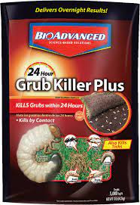
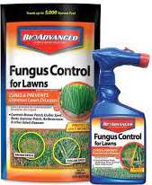
PLANT RECOVERY CONTROLLING INSECTS AND DISEASES ON TURF
INSECTS:
Grubworms (also fire ants)
DISEASES:
Pythium, Rhizoctonia, Grey Leaf Spot

Slide 7
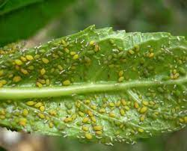
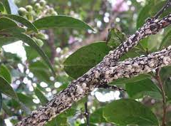
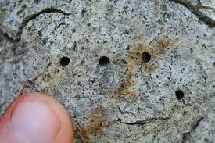
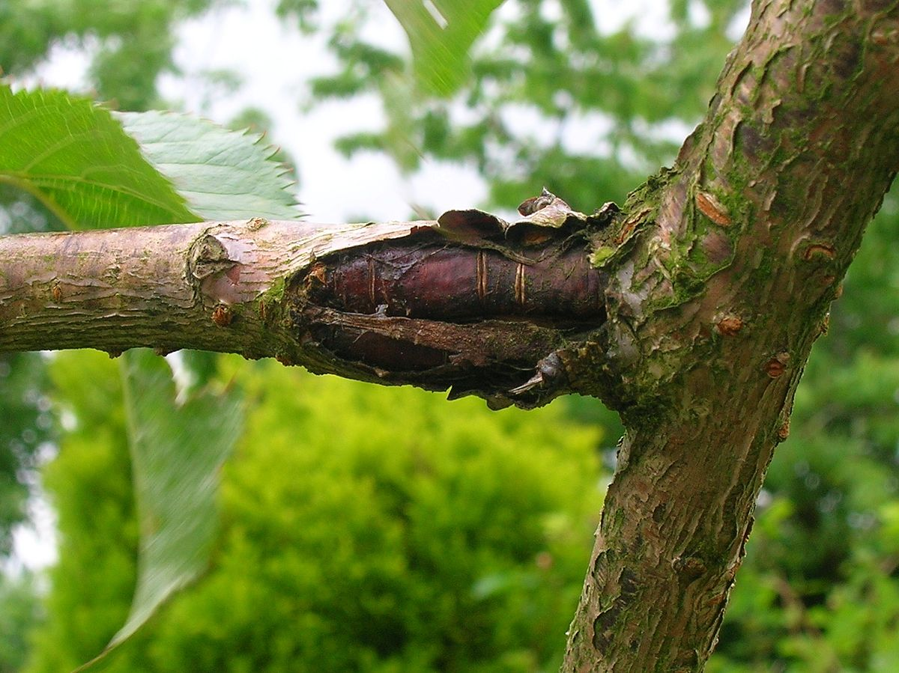
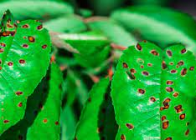
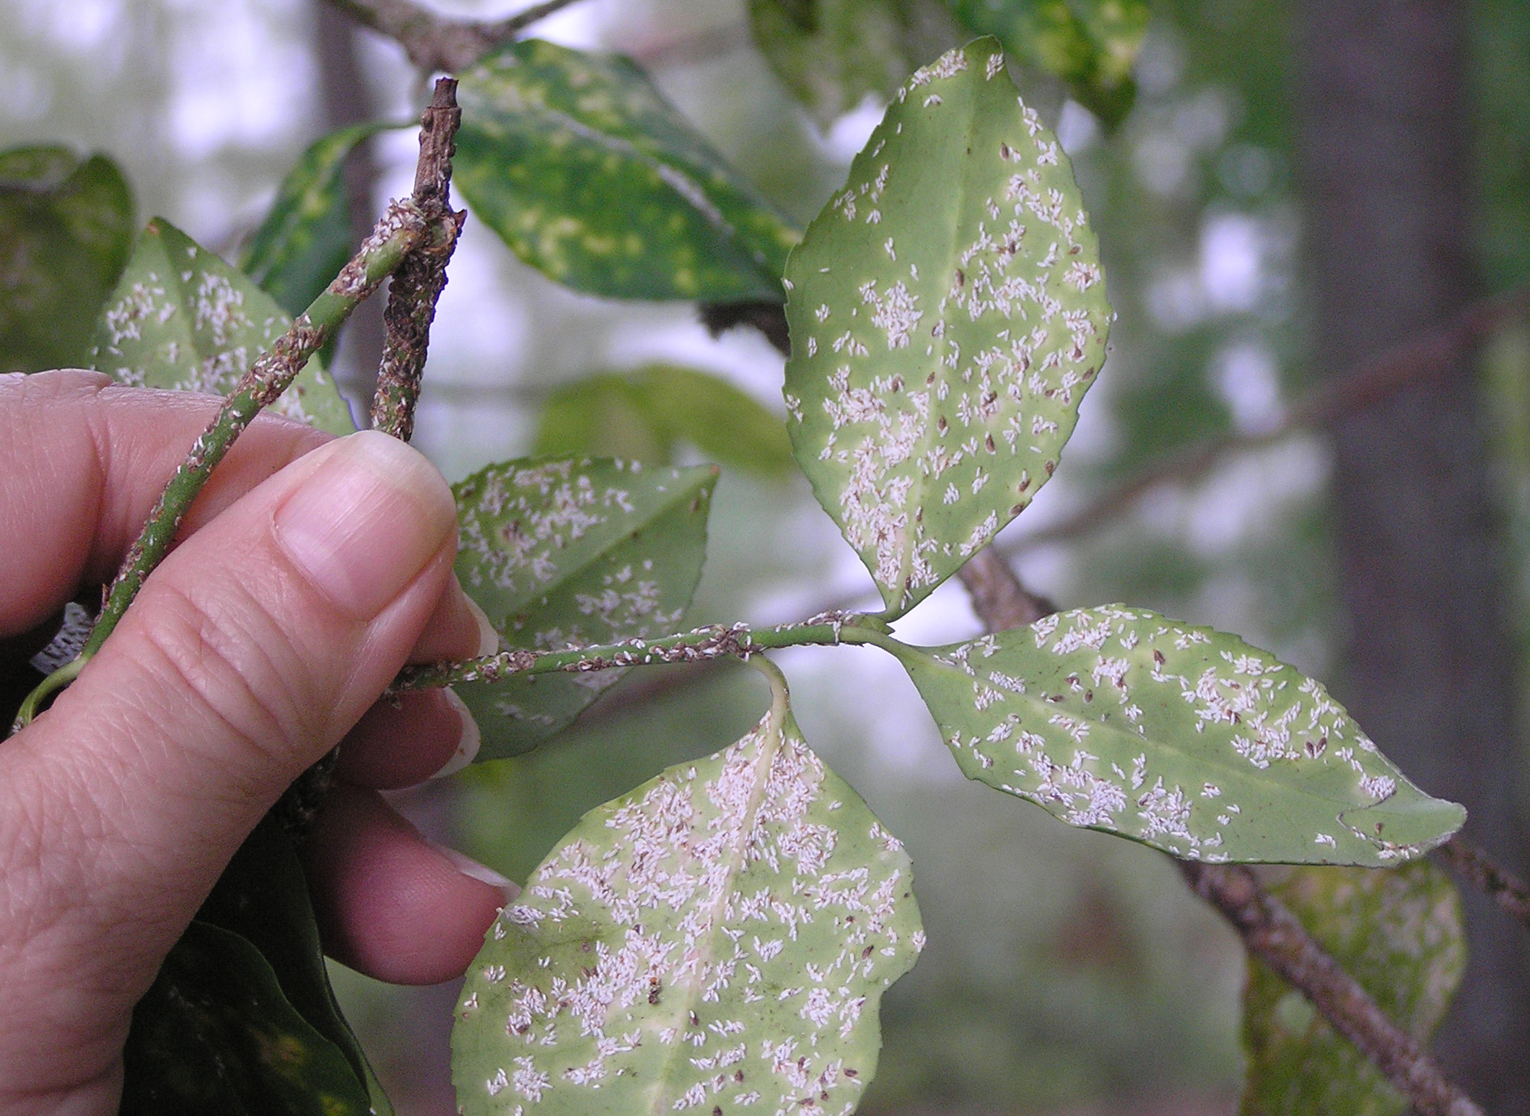
INSECTS:
Aphids
INSECTS:
Scale
INSECTS:
Borers
PLANT RECOVERY
CONTROLLING INSECTS AND DISEASES ON TREES AND SHRUBS
DISEASES:
Canker
DISEASES:
Leaf Spot
DISEASES:
Powdery Mildew

Slide 8
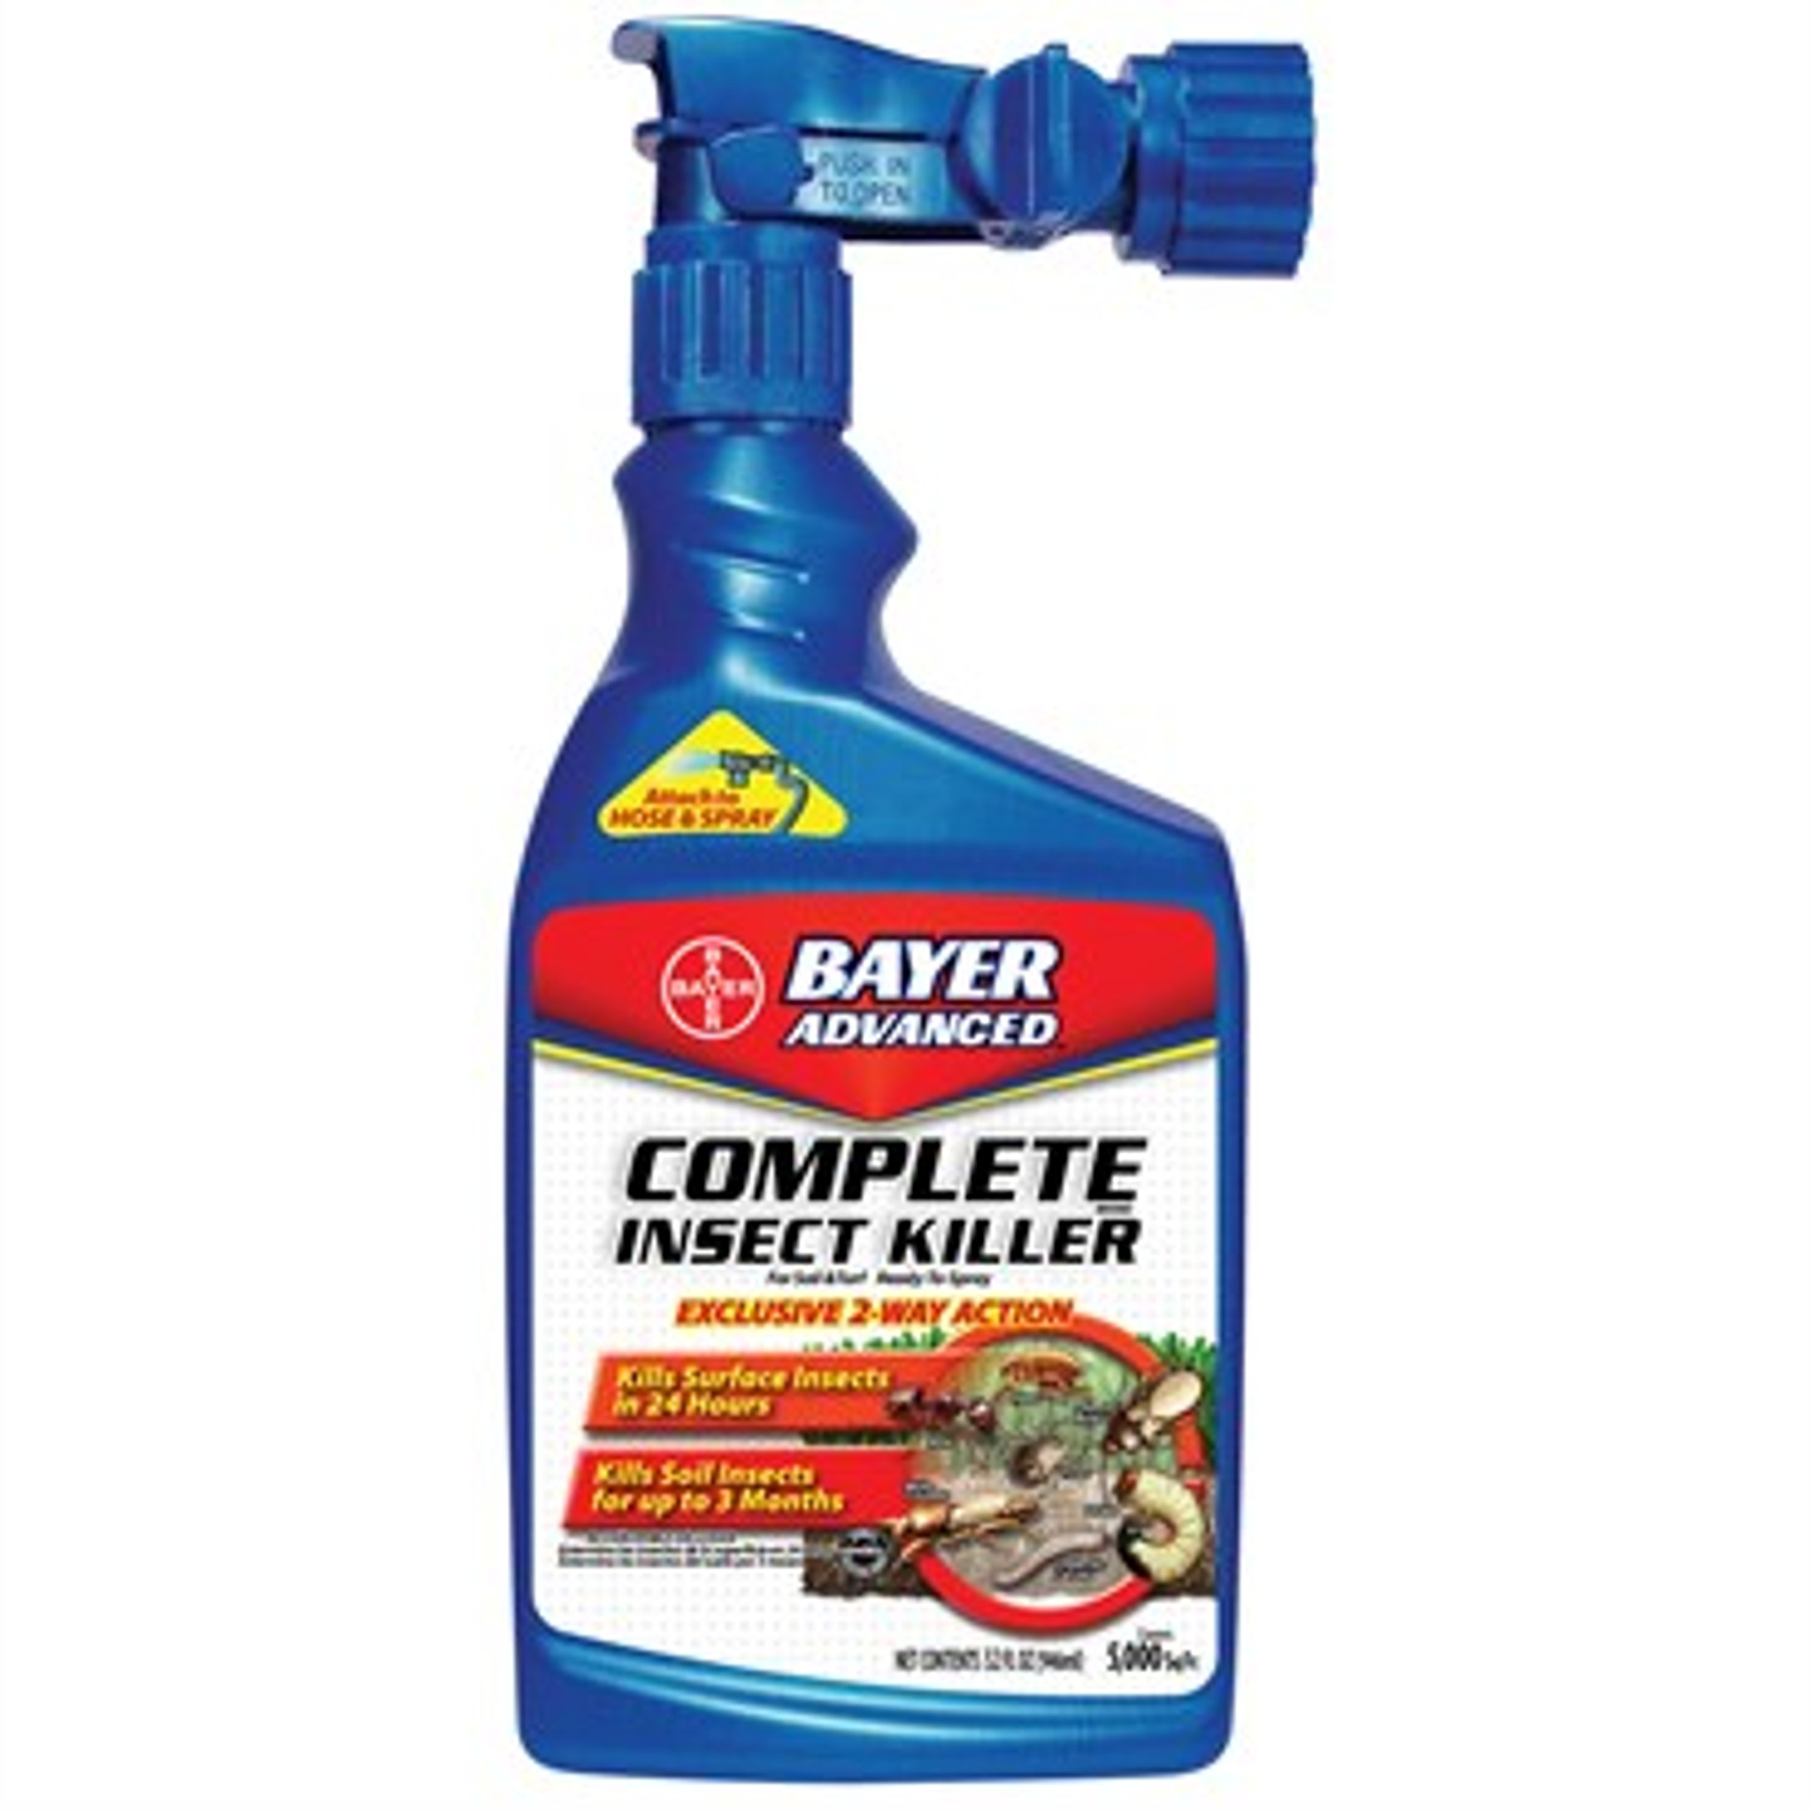
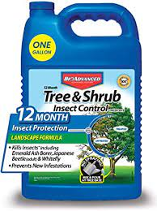
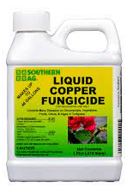
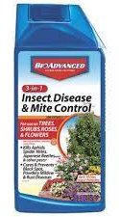
INSECTS:
Aphids (500+)
INSECTS:
Scale, Borers (+40 Systemic)
PLANT RECOVERY
CONTROLLING INSECTS AND DISEASES ON TREES AND SHRUBS
DISEASES:
Canker
DISEASES:
Leaf Spot, Powdery Mildew, Rust

Slide 9
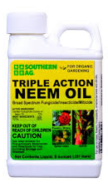
NEEM OIL – THE GOLD STANDARD FOR CONTROL OF INSECTS, MITES AND SOME DISEASES!
Organic
Safe for all plant materials
Safe for the environment
Spray all plant materials in the winter for control of overwintering insects, mites and diseases

Slide 10
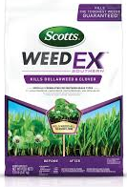
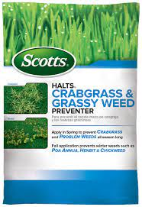
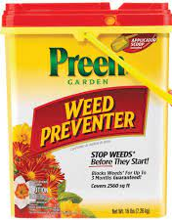
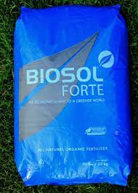
PLANT RECOVERY Pre and Post Emergent Weed Control and Fertilizer for Turf and Beds
Depending on condition of your turf, eliminate weed competition. Apply a post-emergent weed control such as Scott’s Weed X for Southern Grasses. Treat with Halts pre-emerge for Turf and Preen pre-emerge for beds to control germinating weeds.
Do fertilize to encourage recovery and vigor with a slow-release fertilizer.

Slide 11
Mulch beds and tree rings to improve appearance, conserve moisture and provide protection from line trimmer damage, mower damage and winter freeze.
Prune trees for shape and corrective pruning.
Fertilize trees to encourage vigor.
Prepare seasonal color beds for fall and winter planting.
Select fall/winter color.
Add decorations to landscape for fall interest.
Fall is the best time to plant or replace trees!
OTHER TIPS FOR YOUR LANDSCAPE

Slide 12
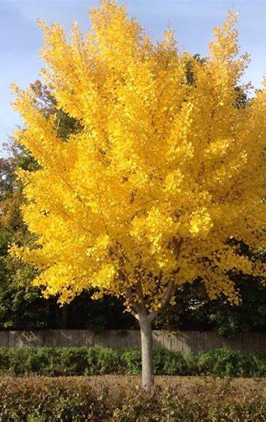
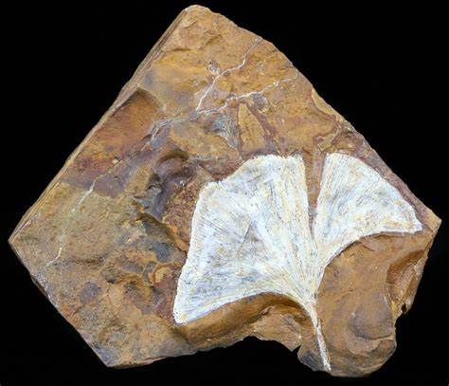
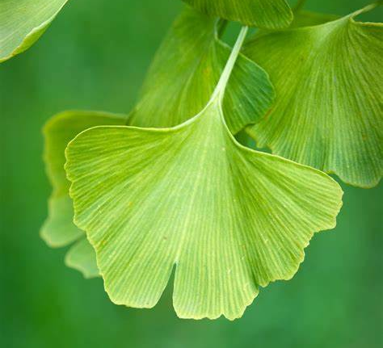
GREAT TREE FOR SMALL AREA: AUTUMN GOLD GINKGO TREE (A FOSSIL TREE)

Slide 13
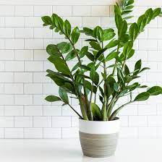
GREAT INDOOR PLANT: ZZ PLANT (requires very little water and thrives in low light areas)

