Slide 1
MAINTAINING YOUR LANDSCAPE Presented by Dr. Robert E. Moon, Horticultural Consultant
POMONA HOA MAY 11, 2023

Slide 2
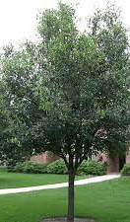
Tips to Rejuvenate Freeze Burned Plant Material
TREES: Due to the early freeze, there was some early leaf drop, brown in Eastern Red Cedar and damaged leaves on broadleaf evergreens.
FERTILIZE TREES: Fertilize trees this month with 1/3 to 1/2 pound of turf fertilizer per inch trunk diameter of tree. Spread fertilizer evenly from trunk to past drip line of tree.

Slide 3
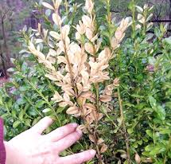
Tips to Rejuvenate Freeze Burned Plant Material
SHRUBS: Some shrubs had damaged leaves but these will drop off as we go into spring green up. Wait to prune until green up begins. Fertilize in May to improve vigor.
GROUND COVER: Some plants will have burned or yellow leaves that will drop off at green up. Fertilize in May to improve vigor.

Slide 4
Tips to Rejuvenate Freeze Burned Plant Material
PLANTS WITH UNDERGROUND RHIZOMES: Foxtail fern, dianella, liriope, etc., have burned leaves that can be cut back at any time. Fertilize in May to improve vigor.
ORNAMENTAL GRASSES AND PERENNIALS: These plants should all recover. Fertilize in May to improve vigor.

Slide 5
Tips to Rejuvenate Freeze Burned Plant Material
BERMUDAGRASS: Bermudagrass should have no damage since it was dormant going into the freeze. Fertilize in May to encourage new growth and improve vigor.
Bermudagrass has been slow to come out due to the cooler night temperatures.
If Bermudagrass went into the December arctic blast, there may be some dead areas but with fertilization, it should recover.
It is very important to protect plants by watering before going into a cold spell. This can’t be over emphasized!

Slide 6
FERTILIZER
Quick Release
Slow Release
Nutrients readily available with rain or irrigation
Stimulate quick leaf growth and greening
Provides more uniform growth
Less likely to burn
Lasts longer in soil
Less polluting
Example: Ammonium Sulfate
Example: Bio-Sol (plant-based), Milorganite (animal-based) Nitroform (Urea Formaldehyde) or Nutralene (Methylene Urea)

Slide 7
FERTILIZER
When to Apply
Bermudagrass
How Much to Apply
March
May/June
September
Follow label on fertilizer selected

Slide 8
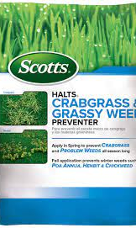
PRE-EMERGENT WEED CONTROL
Why use a pre-emergent
When to apply a pre-emergent (for warm season grasses): February, May, September
Kind of pre-emergent to apply
How much to apply
Follow label directions

Slide 9
WATERING
The irrigation system will be switched to OFF position October through May and the following run times in those months will only apply during periods of drought.
FEBRUARY – Set to run 1 time every 2 weeks
MARCH and APRIL– Set to run 1 time every 7 to 10 days
May – Set to run 1 or 2 times per week
JUNE, JULY and AUGUST – Set to run 2 times per week
SEPTEMBER, OCTOBER and NOVEMBER – Set to run 1 or 2 times per week
DECEMBER AND JANUARY – Turn Controller OFF if there is plenty of rain or set to run 1 time every 2 weeks

Slide 10
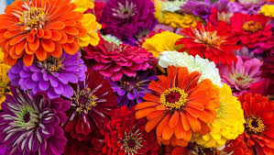
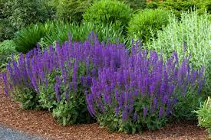
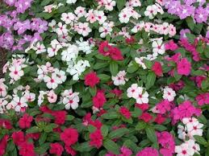
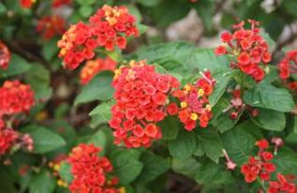
ANNUAL COLOR - SUN
Zinnia
Salvia
Periwinkle
Lantana – Texas Red

Slide 11
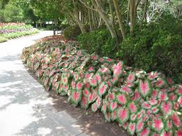
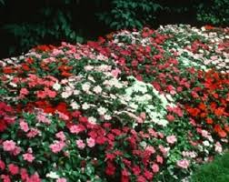
ANNUAL COLOR - SHADE
Impatiens
Caladiums

Slide 12
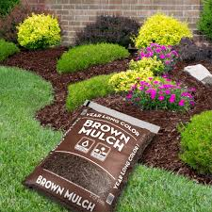
MULCHING
Why to mulch:
To prevent weeds
To conserve water
Improves bed and tree ring appearance
Type of mulch:
Brown Mulch
Dyed-Brown, Double-ground mulch
No other color mulches are acceptable
Maintain at a depth of no more than 2”

Slide 13
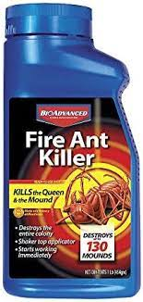
FIRE ANT CONTROL – TEXAS TWO STEP
STEP ONE – Apply a bait
STEP TWO – Mound Treatment

Slide 14
IT IS YOUR TURN!
Q & A

